Slide 1
MAGIC NUMBER SEVEN
Seven Principles for Good Practice in Undergraduate Education
TASS, March 2013

Slide 2
Barbara Dean Wolfe Assistant Dean, Hillyer College Chair, Department of Academic Strategies University of Hartford 200 Bloomfield Avenue West Hartford, CT 06117 860-768-4697

Slide 3
MAGIC NUMBER SEVEN
Seven Principles for Good Practice in Undergraduate Education

Slide 4
CHICKERING AND GAMSON’S SEVEN PRINCIPLES
Encourages contact between students and faculty,
Develops reciprocity and cooperation among students,
Encourages active learning,
Gives prompt feedback,
Emphasizes time on task,
Communicates high expectations, and
Respects diverse talents and ways of learning.

Slide 5
Contact between students & faculty, active learning, cooperation among students

Slide 6
AACU’S LEAP PRINCIPLES OF EXCELLENCE
Aim high and make excellence inclusive
Give students a compass
Teach the arts of inquiry and innovation
Engage the big questions
Connect knowledge with choices and action
Foster civic, intercultural, and ethical learning
Assess students’ ability to apply learning to complex problems

Slide 7
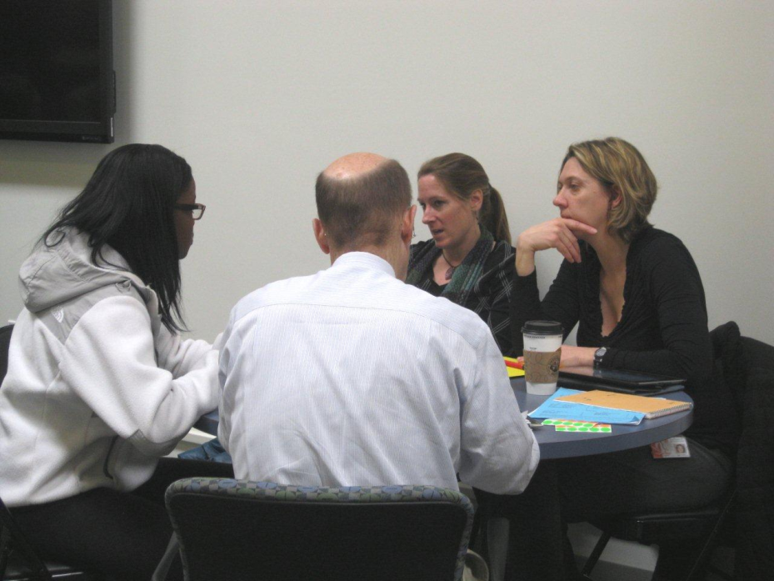
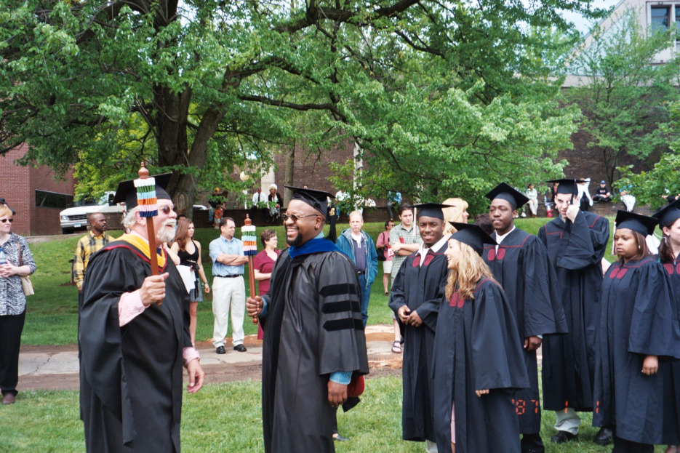
Connect knowledge w/ choices & action; foster civic & ethical learning; teach arts of inquiry & innovation

Slide 8
STEPHEN R. COVEY’S THE SEVEN HABITS OF HIGHLY EFFECTIVE PEOPLE
Be proactive
Begin with the end in mind
Put first things first
Think win-win
Seek first to understand, then to be understood
Synergize
Sharpen the saw

Slide 9
Begin with the end in mind; value differences to strengthen cooperative effort; consider the ideas of others

Slide 10
YOUR TURN
Learning occurs when there is engagement and experience.

Slide 11
Apply Chickering and Gamson’s Seven Principles for Good Practice
First, form groups
Within your small group, share activities you have used in your classes to illustrate each of Chickering and Gamson’s seven principles.
Finally, share your activities with all of us.

Slide 12
REFERENCES
Start with: Chickering, A. W., & Gamson, Z. F. (1987). Seven principles for good practice in undergraduate education. AAHE Bulletin, 39(7), 3-7.
Then see the handout accompanying this session.

Slide 13
THANK YOU
FOR SHARING YOUR EXPERIENCE AND IDEAS

